Slide 1
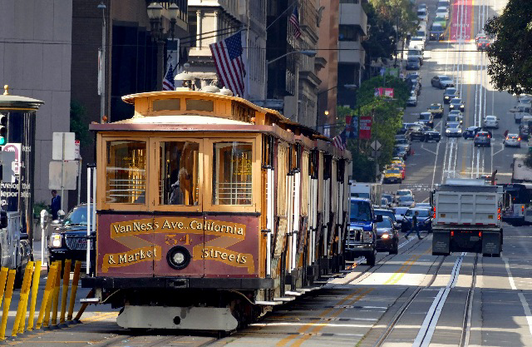
FOLOKIT / WEEKEND PLAN
A city
weekend
San Francisco
Two days. A slower pace.
Photo: Bernard Spragg. NZ · CC0 · Wikimedia Commons
01 / City weekend slides

Slide 2
Two days, three highlights
01
02
03
Waterfront
Cable cars
Neighborhoods
Walk by the bay
and enjoy the view.
See the hills from
a different perspective.
Coffee, a local park
and a museum stop.
02 / Keep time for spontaneous discoveries

Slide 3
A balanced weekend
Leave some space
This illustrative schedule balances exploring with resting.
Figures are planning examples.
03 / Café · 2026–2027 · 中文排版示例

